Slide 1















N-Tier Layered Architecture in .NET Framework
Presented by:- Yuraj Singh

Slide 2


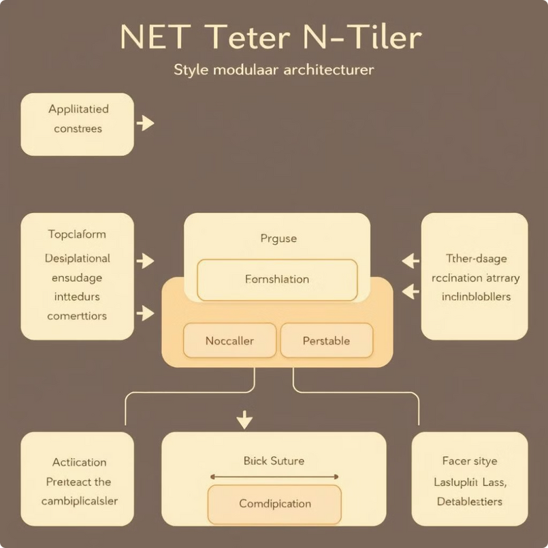
N-Tier Layered Architecture in .NET Framework
N-Tier architecture is a common way to build .NET applications. This approach divides applications into separate layers, each with its own specific purpose. This separation makes applications easier to manage, scale, and update. Developers can focus on individual layers without affecting the rest of the system.

Slide 3
What is N-Tier Architecture?
Modular Design
Separation of Concerns
Flexibility
N-Tier architecture breaks down an app into separate parts, like a presentation layer, a business logic layer, and a data access layer. Each part has its own job.
This separation makes it easier to fix problems, test things, and change each part independently, resulting in a more flexible app that can grow with your needs.
By keeping these parts separate, changes in one part don't affect the others, making the app more flexible and reducing the chance of unexpected issues.

Slide 4

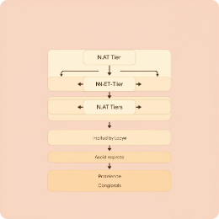
Layers of N-Tier Architecture
Presentation Layer
1
This layer is responsible for the user interface and how users interact with the application. It handles user input and shows output on the screen.
2
Business Logic Layer
This layer contains the core logic of the application. It processes data and ensures that business rules are followed.
Data Access Layer
3
This layer manages communication with the database. It hides the details of how data is stored and provides a simple way for other layers to access the data.

Slide 5

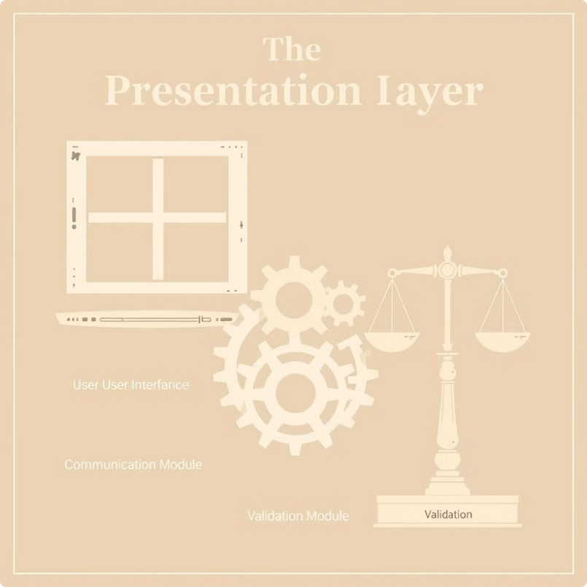

Presentation Layer
1
User Interface
2
Communication
Shows the app's interface, takes user input, and displays data.
Talks to the Business Logic Layer to get and send data and do actions.
3
Validation
Checks user input before sending it to the Business Logic Layer.

Slide 6

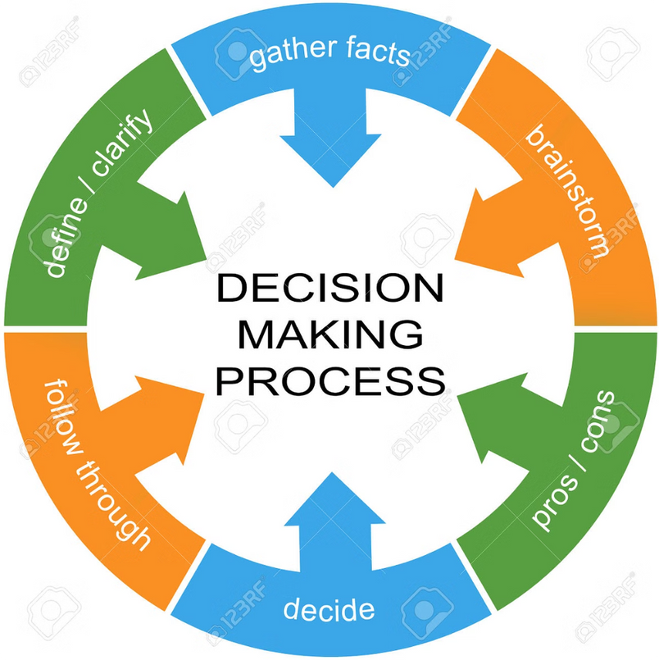
Business Logic Layer
Core Functionality
Data Transformation
This layer carries out the app's key tasks and rules, managing data and how information flows.
This layer converts data between the user interface and the database layer to keep it accurate and consistent.
Security & Authorization
Logging & Monitoring
This layer handles user logins, permissions, and access control to safe sensitive data and features.
This layer records important events and provides tools for troubleshooting and checking performance.

Slide 7


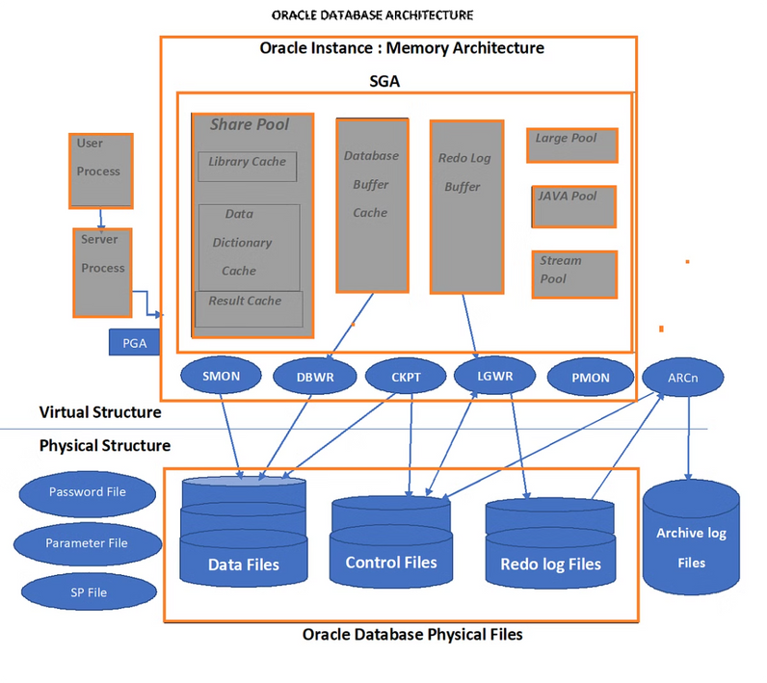


Data Access Layer
Connect to the Database
Lets the Business Logic Layer talk to the database in a simple way.
Get Data
Handles getting data from the database in the best way possible.
Save Data
Makes sure data is stored and retrieved correctly, keeping it safe and consistent.

Slide 8


Database Layer
Data Storage
Stores and manages the app's data.
Query Optimization
Makes queries run faster.
Backup and Recovery
Protects against data loss.

Slide 9

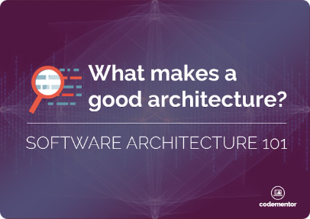



Advantages of N-Tier Architecture in .NET
Modularity
Scalability
Flexibility
Makes it easy to maintain, test, and update each layer separately, without affecting the whole system.
Allows you to increase the size of each layer independently, based on how much each layer is used.
Lets you adjust the application to new needs by changing or replacing specific layers without affecting the whole app.

Slide 10

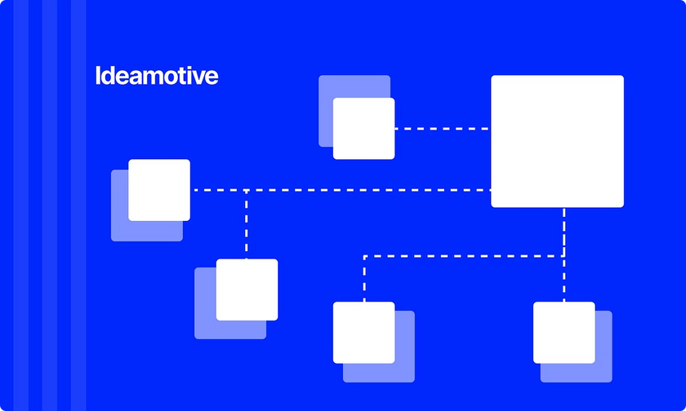
Best Practices for Implementing N-Tier in .NET
1
Separate Layers
2
Use Dependency Injection
Design your layers to be independent, reducing the need for them to rely on each other.
Inject dependencies to make your application easier to test and maintain.
3
Define Layer Interfaces
4
Use Asynchronous Programming
Create interfaces for each layer to define how they interact.
Use asynchronous programming for better responsiveness and scalability.

Slide 11


